Slide 1

APARTMENT PRICE PREDICTION
CUPSTONE PROJECT
by
Ilan Avshalom
Data Scientist & Director at StrataBook
31/07/2019
Notes:
Title
Name date bio

Slide 2
AGENDA
Domain Context
Business Problem
Data Process
Delivery
Conclusion & Recommendations
Notes:
Agenda:
Define
Design
deliver

Slide 3
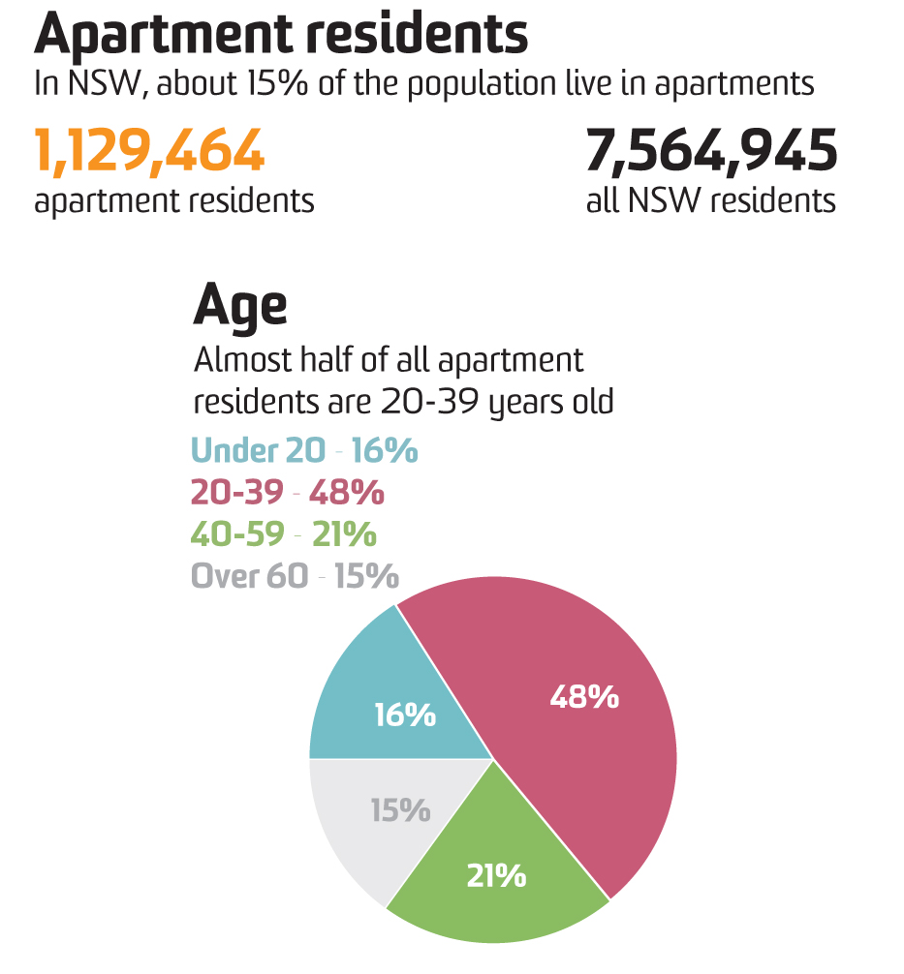
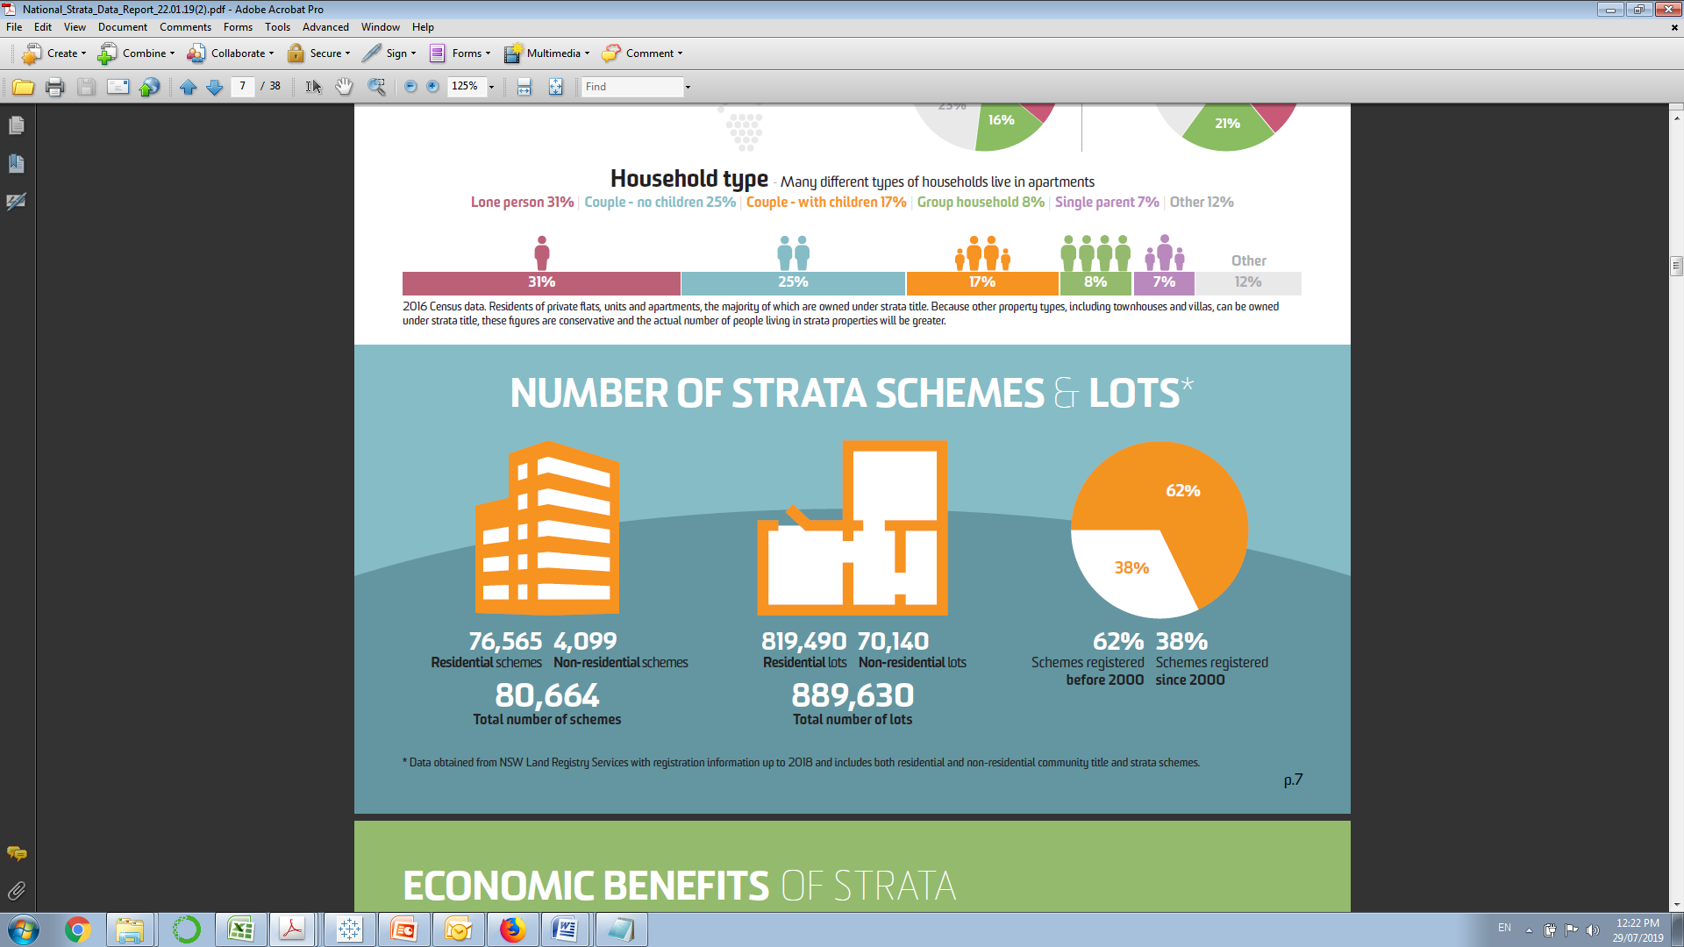
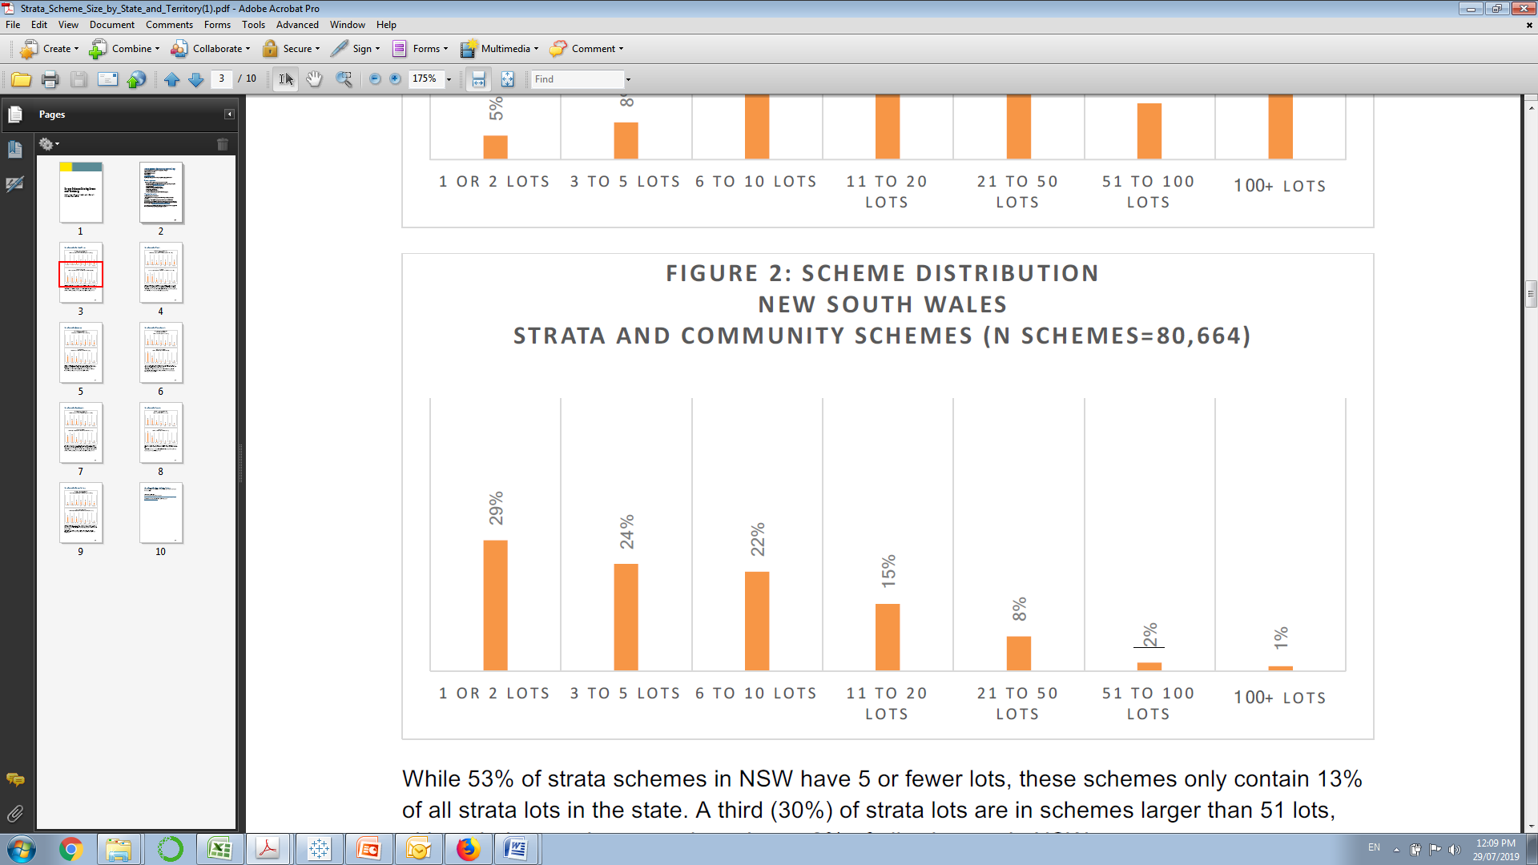
APARTMENT MARKET INSIGHTS
NSW Strata And Community Schemes (N Schemes=80,664)
https://strataville.com.au/strata-in-australia-data-statistics/
It is important to have a professional inspection carried out of the records, prior to making a purchase decision.

Slide 4

THE BUSINESS
STRATABOOK T/A
Conduct independent inspections of body corporate records on behalf of vendors/buyers and their representatives. The report provides a thorough, historical and chronological perspective of a building.
BUSINESS PROBLEM:
We want to add value to end-users by providing a price prediction
for listed apartments.
Notes:
Context about the domain

Slide 5
BUSINESS QUESTION:
Can we provide price prediction for appartments?
Providing such feature will:
Improve engagement with registered users and partners
Enhance user’s experience of making purchase decision
Increase site traffic
Collect leads
Improve conversion rate -currently we experience a 30% conversion rate of visitors to orders & purchases from our site
DATA QUESTION:
Based on property historical sales and land valuation data how accurately can we predict the price of an apartment?

Slide 6
DATA PROCESS
Dataset | Description
History of sales CoreLogic CSV file | (16197, 41); 1 & 2 bed units, max price $1.5M, selected suburbs, since 01/01/2018
Distance to the CBD freemaptools.com CSV file | (528, 3) Selected postcodes
Land Valuation data NSW Gov. Valuer General Zip file -130 CSV files | (2490004, 35); All properties (76011, 37); Registered Strata Plans ((15714, 25); SP of selected districts
Extract Strata plan numbers, subdivisions and number of Lots
Create features based on domain knowledge and merge datasets
Features selection & optimization
Evaluate classification
models and select best
Refine and tune model

Slide 7
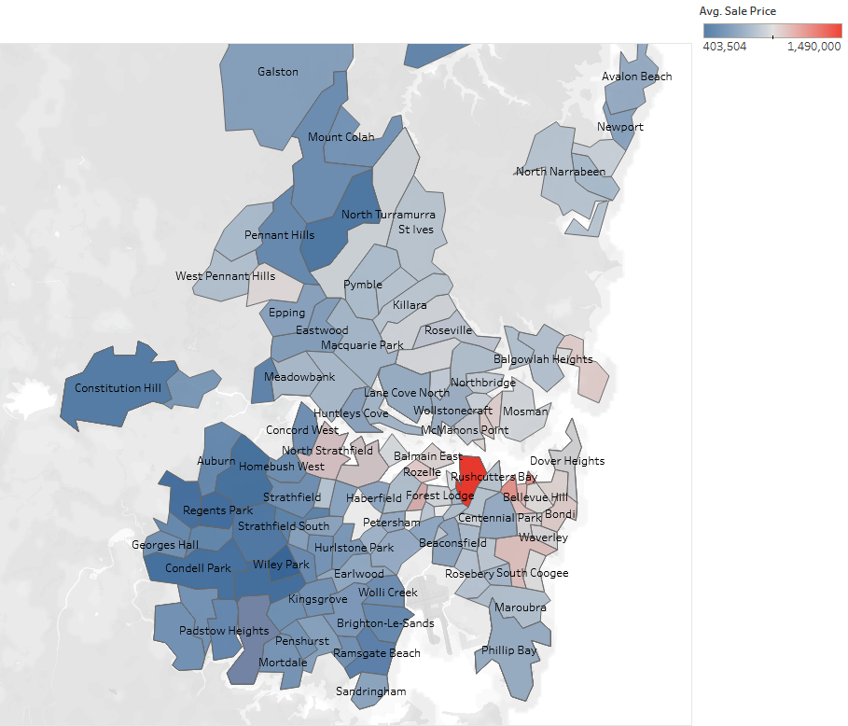
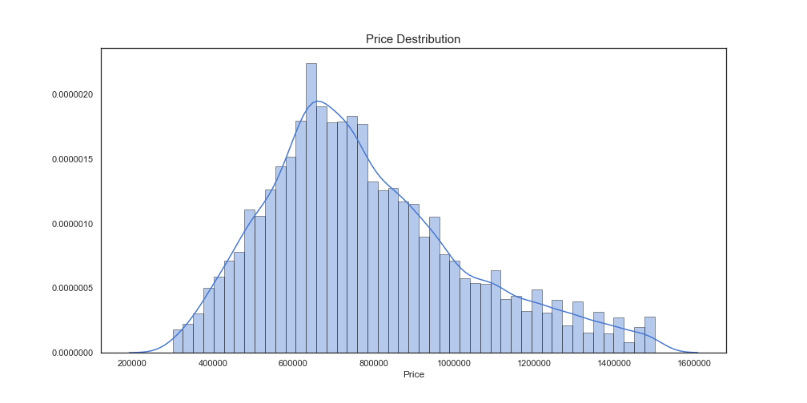
DELIVERY
Merged Dataset (14157, 20)
Notes:
Data sources

Slide 8
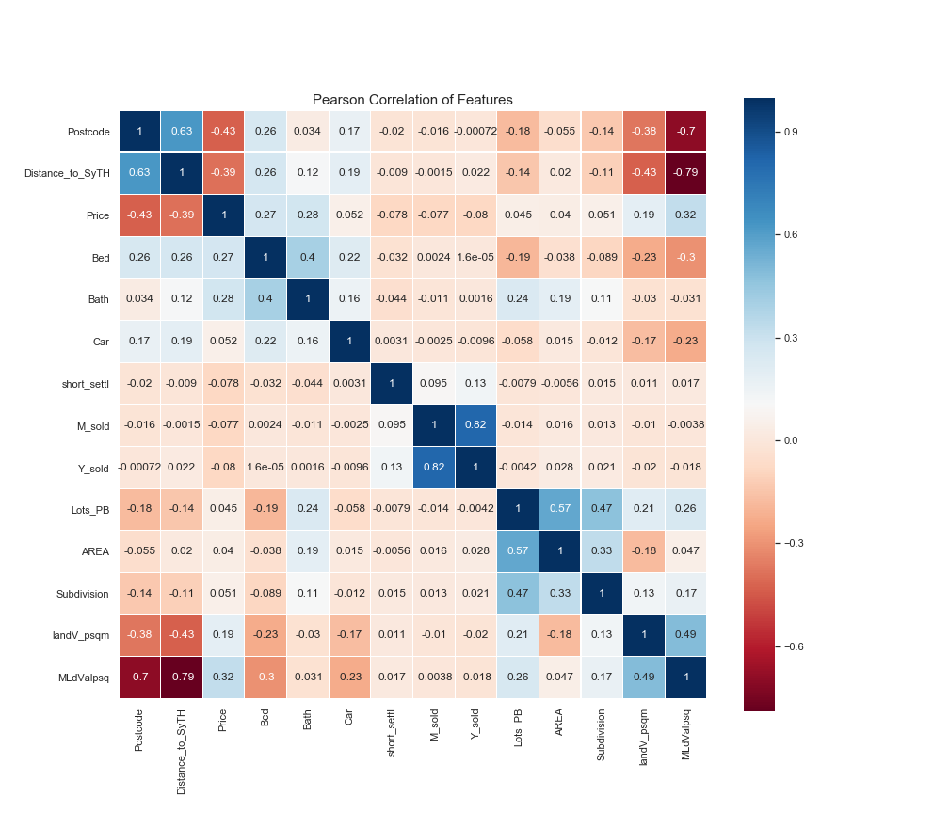
DELIVERY

Slide 9
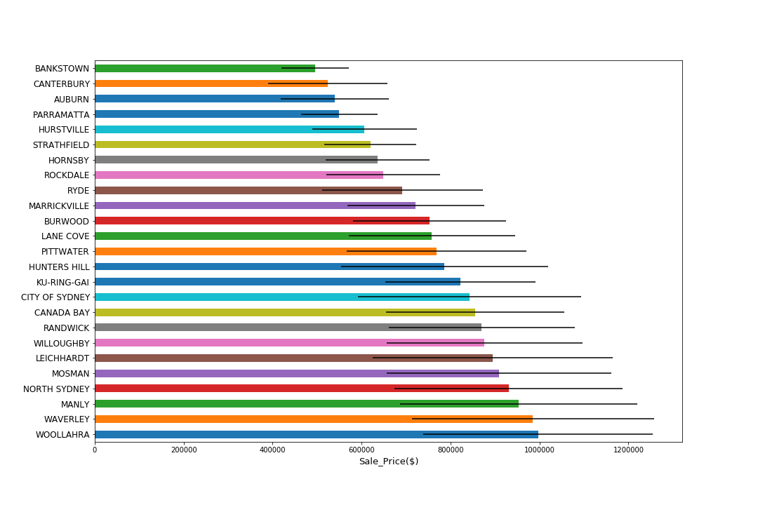
DELIVERY
Mean Sale Price per Districts
Notes:
Data sources EDA

Slide 10
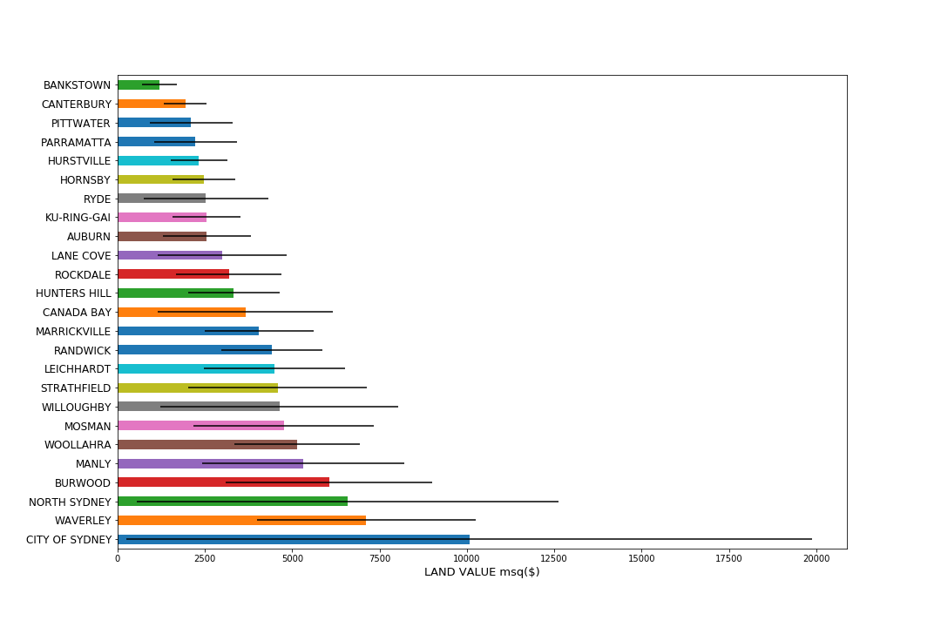
DELIVERY
Mean Land Value per sqm in Districts
Notes:
EDA continued

Slide 11
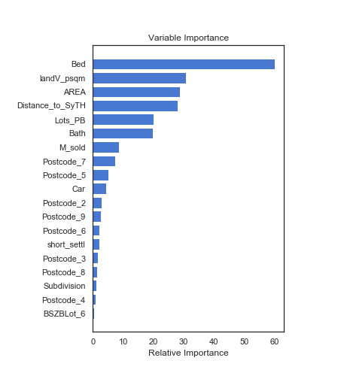
DELIVERY
Sydney Apartment price prediction accuracy 73.6%
Linear Regression Model
R² = 0.504
Ensemble Gradient Boosting Regressor
Score = 0.6318
Ensemble Gradient Boosting Regressor
N_estimators = 500
Min_samples_split = 4
Score = 0.736
Notes:
Models sydney

Slide 12
CONCLUSION
Our analysis of the compiled dataset and model development
offers the following insights:
Based on property historical sales and land valuation data we can predict the price of 1 & 2 bedroom units in Sydney with an accuracy of 73.6%
We can add value to vendors/buyers and their representatives (end users) with a price prediction feature
Features form the all 3 dataset used for this projects contributed to the success of our model
Using domain knowledge enabled us to create meaningful features and reasonable model accuracy
Notes:
Conclusion

Slide 13
RECOMMENDATIONS
Our recommendations for the next step are as follow:
Accuracy of the proposed model can be further enhanced
Further data on building should be sourced, that may produce grater model accuracy
Prediction page should include information about the building, listing related “on the market” apartments
A link to price prediction feature from StrataSellfast website is possible after deployment of the model, it will improve engagement with registered users and partners
Notes:
Conclusion

Slide 14
SUPPORTING DOCUMENTS
GitHub: (DSIA-Education/DSIA-SYD-March-2019/tree/master/Ilan/Capstone2019)
NB_1_Land_data.ipynb
NB_2_Sales_data.ipynb
NB_3_Merged_data.ipynb
NB_4_SydneyEDA.ipynb
NB_5_Features.ipynb
NB_6_Modelling.ipynb
Project Document DSIA2019v1.docx
Notes:
Conclusion

Slide 15
THANK YOU
QUESTIONS?
Notes:
Conclusion

